Slide 1
Psychology…
Human Diversity…
Adjustment
Critical Thinking…
Studying…

Slide 2
Why Psychology?
Because it is ideally suited to help us meet the challenges that we encounter in life.
Psychology is a scientific approach to the study of behavior and mental processes.
Psychology can be applied to our lives to help us adjust.

Slide 3
What is Adjustment?
Adjustment (coping) is behavior that permits us to meet the demands of the environment.
People are not merely reactors to their environments. People are also actors who influence their surroundings. We act upon the environment to meet our needs and pursue our goals.
To achieve psychological fulfillment, we must act…not merely react. Adjustment allows us to grow as individuals.

Slide 4
Nature versus Nurture
Psychologists are concerned with the degree to which our traits and behavior patterns reflect our nature (genetics) and our nurture (environment).
What do you think? Is biology our destiny? Or does the environment have more of an impact upon our behavior?

Slide 5
Nature versus Nurture (cont.)
It appears that genetic factors are involved in nearly all human traits and behavior.
Genes play a role in our response to stress, our levels of obesity and addictions to name a few.
However, genetic factors cause predispositions…not specific behavior patterns. Genetic factors interact with other factors such as learning experiences and personal choice to determine behaviors, disorders and traits.

Slide 6






Human Diversity

Slide 7
Human Diversity
The nation now contains more kinds of people and more ways of doing and viewing things than most of us might imagine. One type of diversity is ethnicity.
Ethnic Groups: Groups of people who can be distinguished by characteristics such as their cultural heritage, common history, race and language.

Slide 8
Why study diversity?
Experiences of ethnic groups in the United States highlight the impact of social, political, and economic factors upon human behavior and development.
To appreciate both the rich heritage and the historical struggles of various ethnic groups.
To help us better understand and fully appreciate the true extent of human behavior and mental processes.
To comprehend the dramatically changing ethnic composition of our society.

Slide 9
Critical Thinking
Psychology is a science and provides us with a scientific approach to coping with the challenges of life. The scientific approach utilizes critical thinking.
Critical thinking is an approach to thinking characterized by skepticism and thoughtful analysis of statements and arguments—for example, probing arguments’ premises and the definition of terms.

Slide 10
Critical Thinking (cont.)
Critical thinking is essential to our adjustment as it allows us to critically evaluate our environment (arguments of a political candidate, whether a diet will work, whether someone is telling us the truth).

Slide 11
Features of critical thinking
Maintain a healthy skepticism.
Exam the definition of terms.
Examine the assumptions or premises of arguments.
Be cautious in drawing conclusions from “evidence”.
Consider alternative interpretations of research evidence, especially of evidence that seems to show cause and effect.
Don’t oversimplify.
Don’t overgeneralize.
Apply critical thinking to all areas of life.

Slide 12
Studying Adjustment
Psychologists use the scientific method to study adjustment issues.
Scientific method: A method for obtaining scientific evidence in which a hypothesis is formed and tested.

Slide 13
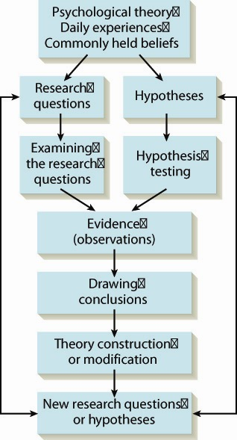
The
Scientific
Method

Slide 14
How Psychologists do Research.
Historically, there has been a bias in favor of conducting research with men and attempting to apply the results to women. Thus, there is a lack of research in women’s versus men’s health issues.
Scientists must realize that they cannot generalize findings to groups that weren’t included in the research.

Slide 15
Case-Study Method
A method of research based on a carefully drawn biography obtained through interviews, questionnaires, or psychological tests.
While the case-study method allows researchers to better understand behavior, a weakness of this method is the social desirability bias which is a tendency for the person being studied to respond in socially desirable ways.

Slide 16
The Survey Method
Surveys are a means of gathering information by which large numbers of individuals are interviewed or asked to complete questionnaires in order to learn about their attitudes or behaviors.
Surveys are often administered to samples and then the results are generalized to the larger population.

Slide 17
The Survey Method (cont.)
Sample: Part of a population selected for research.
Generalize: To apply observations based on a sample to a population.
Population: A complete group of organisms or events.
Random Sample: A sample drawn such that every member of a population has an equal chance of being selected.

Slide 18
Naturalistic-Observation Method
A scientific method in which organisms are observed in their natural environments.
The strength of this method lies in the ability to see “natural” behavior, but the challenge is to study using unobtrusive methods.
Unobtrusive methods are measures that do not interfere with a subject’s behavior.

Slide 19
Correlational Method
A scientific method that studies the relationships between variables.
Correlation coefficient: A number between +1.00 to -1.00 that expresses the strength and direction (positive or negative) of the relationship between two variables.
While this method shows relationships, causation cannot be inferred from that relationship.

Slide 20
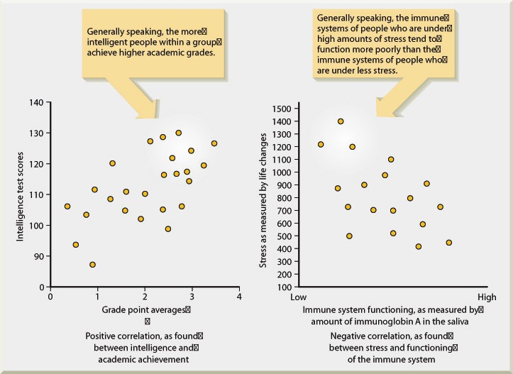
Positive and Negative Correlation

Slide 21
The Experimental Method
A scientific method that seeks to confirm or discover cause-and-effect relationships by introducing independent variables and observing their effects on dependent variables.

Slide 22
Experimental Method (cont.)
Independent variable: A condition in a scientific study that is manipulated so that its effects my be observed.
Dependent variable: A measure of an assumed effect of an independent variable.
Experimental Group: A group of subjects who receive a treatment (independent variable).
Control Group: A group of subjects whose members don’t receive the treatment, while other conditions are held constant. Therefore, one may conclude that group differences following treatment will result from the treatment.

